Slide 1

EDGE DETECTION
M.DURGA PRASAD (RA2211003011093)
V.YASWANTH (RA2211003011123)
N.V.DEEPAK (RA2211003011165)

Slide 2


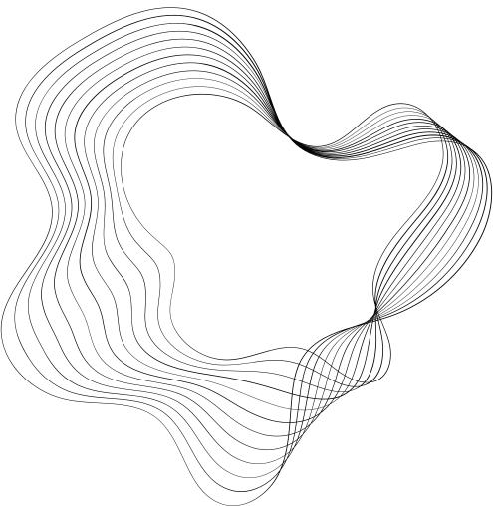

OBJECTIVE
The objective of the edge detection project is to design and implement an automated system capable of accurately identifying edges within images using computer vision techniques. Edge detection serves as a fundamental task in image processing and computer vision, with wide-ranging applications spanning from object detection and recognition to medical imaging and autonomous navigation systems. The primary goal of this project is to develop robust algorithms and methodologies that can effectively extract edges from images, providing a valuable tool for various image analysis tasks. By leveraging techniques such as the Canny edge detector, the project aims to achieve precise edge detection while minimizing false positives and ensuring computational efficiency. Ultimately, the project seeks to contribute to advancements in image processing technology, enabling improved visual analysis, feature extraction, and pattern recognition in diverse fields of research and industry.

Slide 3
SCOPE
The scope of this project revolves around the development of an edge detection system employing the Canny algorithm, encompassing various stages from image preprocessing to final visualization and analysis. Initially, the project will entail loading images from different sources, including files and camera streams, followed by conversion to grayscale to facilitate subsequent processing steps. Noise reduction techniques such as Gaussian blurring will be applied to enhance the accuracy of edge detection. The core component of the project involves the implementation of the Canny edge detection algorithm, which will identify edges within the images based on specified threshold values. Fine-tuning parameters will be explored to optimize performance and accuracy, with an emphasis on providing visual feedback through interactive interfaces. Furthermore, efforts will be directed towards optimizing computational efficiency, including parallelization techniques for accelerated processing on multi-core processors or GPUs. Integration into larger applications and systems, along with comprehensive documentation and testing, will ensure robustness and usability. Future directions may involve exploring domain-specific applications, engaging with the community for feedback, and incorporating enhancements to extend the project's functionality and impact. Overall, the project aims to deliver a versatile and efficient edge detection solution capable of addressing diverse image processing challenges while laying the groundwork for further advancements in the field.

Slide 4
TOOLS USED
Edge detection is often implemented using various tools and libraries in the field of computer vision.
1. OpenCV (Open Source Computer Vision Library):
- A powerful and widely used open-source library that provides various computer vision algorithms, including the Canny edge detection method.
2. Matplotlib:
- A popular plotting library in Python that is often used for visualizing images and results, including those obtained from edge detection.
3. NumPy:
- A fundamental library for numerical computing in Python, often used for handling image data and mathematical operations.
4. Scikit-Image:
- An image processing library built on NumPy and SciPy, which includes various image processing algorithms, including edge detection techniques.
5. ImageJ:
- A popular open-source image processing software that provides a variety of tools, including edge detection algorithms.
6. Dlib:
- A toolkit for machine learning and computer vision, which includes tools for facial recognition and shape prediction based on edge detection.

Slide 5
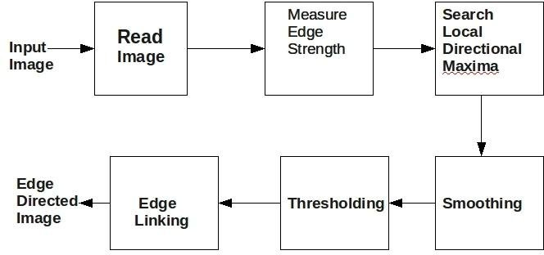
SYSTEM DESIGN/ARCHITECTURE

Slide 6




IMPLEMENTATION DETAILS
LOADING THE IMAGE:
CONVERTING TO GRAYSCALE:
EDGE DETECTION:
DISPLAYING RESULTS:
The Canny edge detection algorithm is applied to the grayscale image using cv2.Canny(). It detects edges based on the gradient magnitude and two threshold values provided (100 and 200).
Finally, the original image and the edge-detected image are displayed using cv2.imshow(). After
waiting for a key press with cv2.waitKey(0), all OpenCV windows are closed with cv2.destroyAllWindows().
Loading the Image:
The code uses the cv2.imread() function to load an image file from the specified path.
After loading the image, it is converted to grayscale using cv2.cvtColor() with the
cv2.COLOR_BGR2GRAY flag

Slide 7
Source code
# Import the OpenCV library
import cv2
# Read the image file
image = cv2.imread('WhatsApp Image 2024-03-11 at 15.03.00_c139421d.jpg')
# Convert the image to grayscale
gray_image = cv2.cvtColor(image, cv2.COLOR_BGR2GRAY)
# Perform edge detection using the Canny algorithm
edges = cv2.Canny(gray_image, 100, 200)
# Resize the edges image to match the original image size
edges_resized = cv2.resize(edges, (image.shape[1], image.shape[0]))
# Display the original image
cv2.imshow('Original Image', image)
# Display the edge-detected image
cv2.imshow('Edge Detection', edges_resized)
# Wait for any key press to close the windows
cv2.waitKey(0)
# Close all OpenCV windows
cv2.destroyAllWindows()

Slide 8


Slide 9
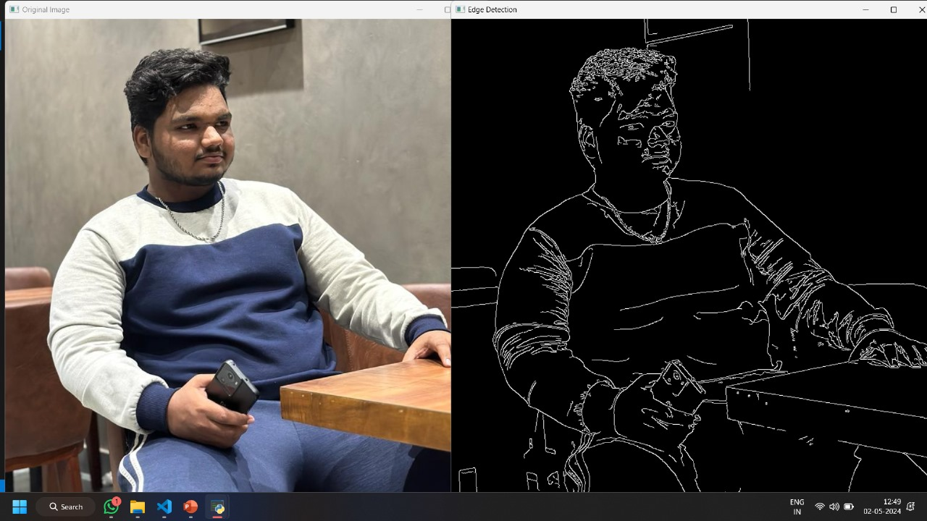
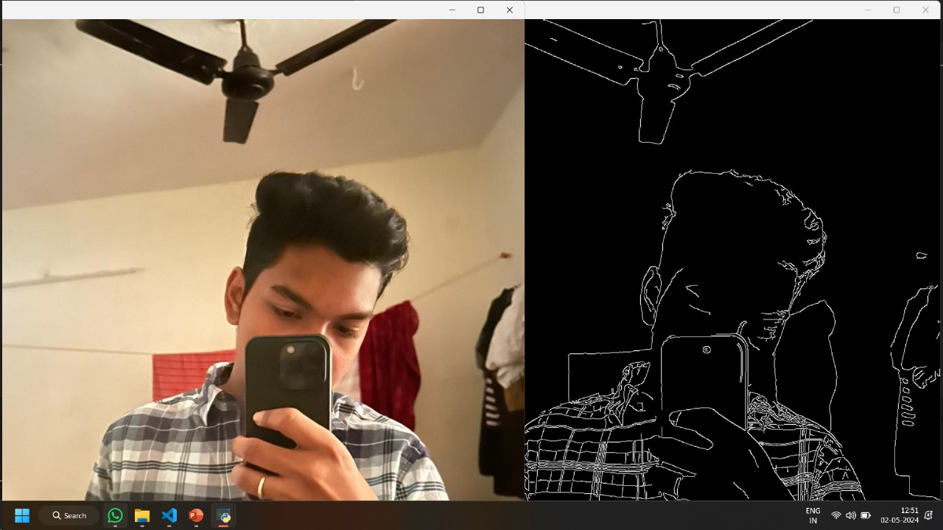
OUTPUT :

Slide 10

CONCLUSION
In conclusion, the provided code demonstrates the implementation of edge detection using the Canny algorithm, a widely-used technique in image processing and computer vision. By loading an image, converting it to grayscale, and applying the Canny edge detection algorithm, the code effectively identifies edges within the image. The resulting edge-detected image highlights regions of significant intensity change, which are crucial for various image analysis tasks.
The ability to visualize both the original image and its corresponding edge-detected version allows for the assessment of the algorithm's performance. This visualization facilitates the evaluation of edge detection accuracy, aiding in the identification of potential areas for improvement or optimization.
Overall, edge detection serves as a fundamental step in many image processing applications, including object detection, segmentation, and feature extraction. By providing a reliable means of identifying edges within images, the implemented algorithm opens up avenues for further analysis and interpretation, contributing to advancements in computer vision technology.

Slide 11
RESULT
The result of the edge detection process is a binary image where edges are highlighted in white and non-edges are shown in black. This binary image represents the detected edges in the original image.
The edge detection algorithm identifies regions of significant intensity change within the image, which typically correspond to object boundaries or other significant features. These regions are highlighted as edges in the output image.
By displaying both the original image and the edge-detected image, users can visually inspect the effectiveness of the edge detection algorithm. They can observe how well the algorithm captures the desired edges and assess any potential false positives or missed edges.
Ultimately, the result of the edge detection process provides valuable information for subsequent image processing tasks, such as object recognition, segmentation, or further analysis of the detected features

Slide 12
THANK YOU

